Slide 1
Security Mechanisms (Authentication)

Slide 2
USER AUTHENTICATION
“ The process of verifying an identity claimed by or for a system entity”
basis for most types of access control and for user accountability
2 Steps in Authentication Process:
Identification Step: Presenting an identifier to the security system
Verification Step: Presenting or generating authentication information that corroborates the binding between the entity and the identifier (e.g. password)
MESSAGE AUTHENTICATION
Making sure that a message was received unaltered and that the source is authentic
Notes:
Identification step - e.g. username
Verification step – e.g. password

Slide 3
TYPES OF AUTHENTICATION
Unilateral or one-way authentication
Only one principal verifies the identity of the other principal
Mutual Authentication
both communicating principals verify each other’s identity

Slide 4
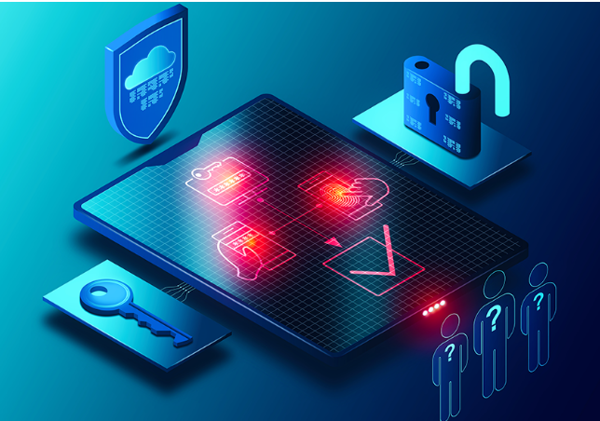
MULTI-FACTOR AUTHENTICATION

Slide 5
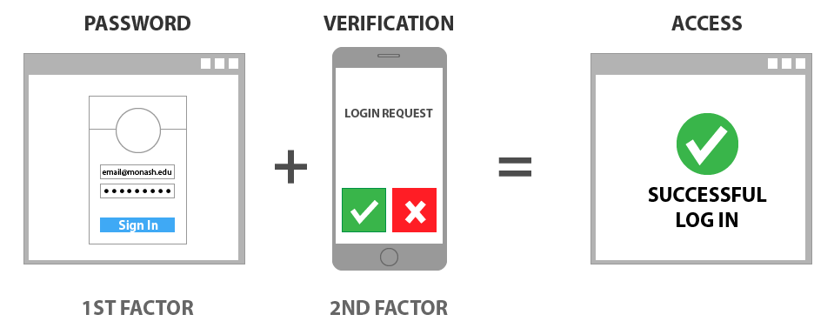
MULTI-FACTOR AUTHENTICATION (MFA)
A security measure that requires two or more proofs of identity to grant a user access to a network, system, or application

Slide 6
MULTI-FACTOR AUTHENTICATION (MFA)
Most authentication factors can be categorized into one of the following groups:
Something You Know: This includes PINs and passwords created by the user, as well as answers to security questions.
Something You Have: This credential requires users to generate or receive security tokens or certificates. This can be done using an authenticator application, or a time sensitive One-Time-Password (OTP) delivered by SMS, email, or secure link.
Something You Are: This includes biometric identifiers based on physiological characteristics such as fingerprints, eye, facial or voice recognition
Something You Do: This includes voice pattern, handwriting, typing rhythm

Slide 7
MULTI-FACTOR AUTHENTICATION (MFA)
Types of Authentication/Authorization Methods:
SMS or Voice
This is a very weak type of MFA which works by sending a code to the user’s phone or email. The user then retrieves this second factor code from their text or email inbox to use for login authentication. This is the weakest form of MFA. It is vulnerable to phishing and SIM swap attacks.
App-based authentication
This is stronger than SMS or Voice MFA. Examples of app-based authentication include one-time password (OTP), mobile push notification and token-based OTP. They verify a user’s identify either by generating OTP codes or by sending “push” pop-up notifications to a user’s mobile application for their approval

Slide 8
MULTI-FACTOR AUTHENTICATION (MFA)
Types of Authentication/Authorization Methods:
Mobile Push Notifications
Vulnerable to MFA fatigue, where scammers use a strategy in which they bombard victims with MFA push notifications until they slip up and mistakenly authenticate the wrong attempts. This method can be further strengthened by using number matching. This is an additional step between receiving and accepting the prompt. The user is required to enter numbers from the identity platform into the application to approve the authentication request.

Slide 9
MULTI-FACTOR AUTHENTICATION (MFA)
Types of Authentication/Authorization Methods:
Phishing-resistant MFA
This is currently the gold standard in MFA. This involves the same authentication process, but people are removed from the process as much as possible. The most common way to implement this is through the FIDO2 standard which uses “WebAuthn” technology. This can significantly reduce the risk of phishing as well as the usefulness of a stolen session token.

Slide 10
How to enable MFA?
Users can often enable MFA in their account’s security settings, or when they create an account. A user may see options to enable MFA listed as “Two Factor Authentication.” Popular forms of MFA include authenticator applications such as Google Authenticator, and OTP received via email or SMS.
When to use MFA?
You should use MFA wherever possible, especially when it comes to your most sensitive data like your primary email, your financial accounts, and your health records.

Slide 11
MESSAGE ENCRYPTION
Message encryption by itself seems to provide a measure of authentication
Symmetric encryption (Single Key encryption)
Public-Key encryption (Asymmetric encryption)

Slide 12
Single Key/Symmetric Encryption
common
key
encrypt
decrypt
Same en/de-crypt key (common key)
DES, 3DES, IDEA, RC2/4/5/6, Blowfish

Slide 13
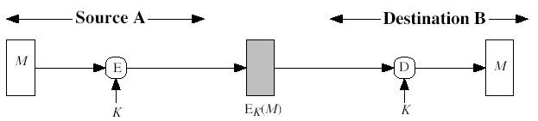
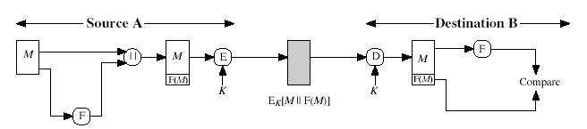
Single or Symmetric Encryption
Symmetric Encryption
Provide confidentiality, authentication
cannot provide signature

Slide 14
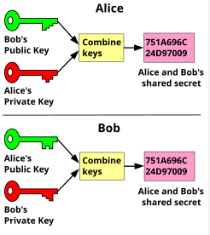
Public-Key or Asymmetric Encryption
Public key encryption is a method of encrypting or signing data with two different keys and making one of the keys, the public key, available for anyone to use. The other key is known as the private key. Data encrypted with the public key can only be decrypted with the private key

Slide 15
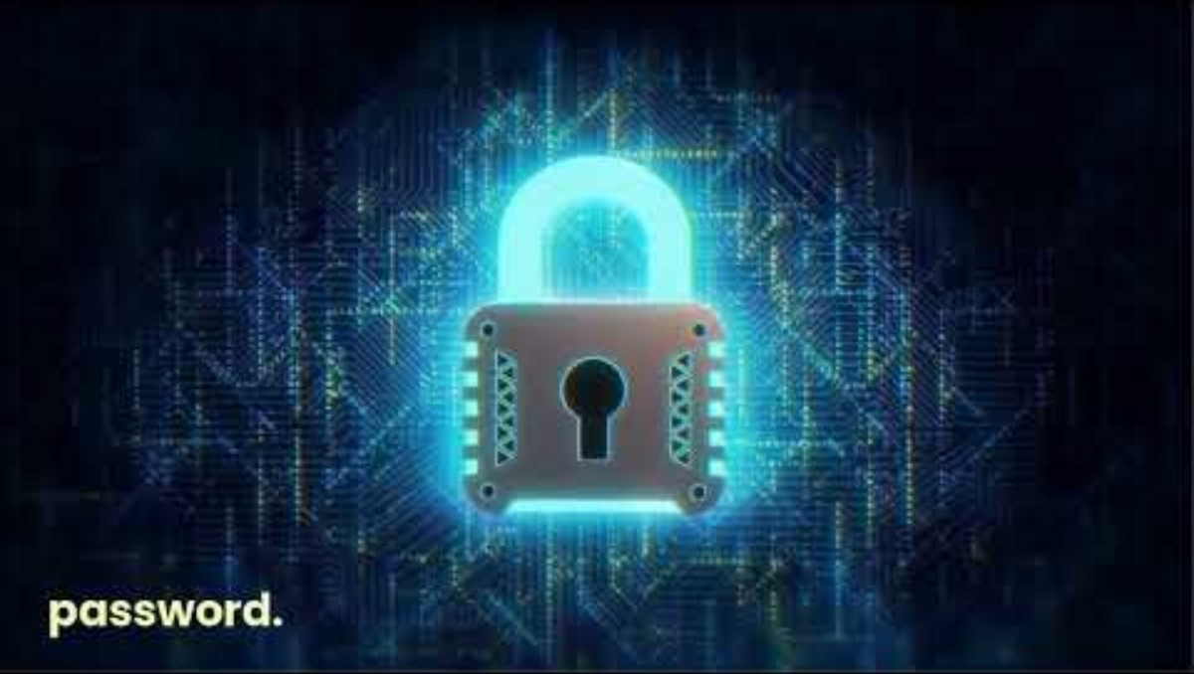

Slide 16
ACTIVITY:
Research about public key infrastructure (PKI). Look for any PKI-based application. Install, configure and test how it works.
Create a user’s manual (with cover and name) on how to use it. Upload your work in the virtual classroom.

Slide 17

BIOMETRIC AUTHENTICATION:
Can We Rely On?

Slide 18
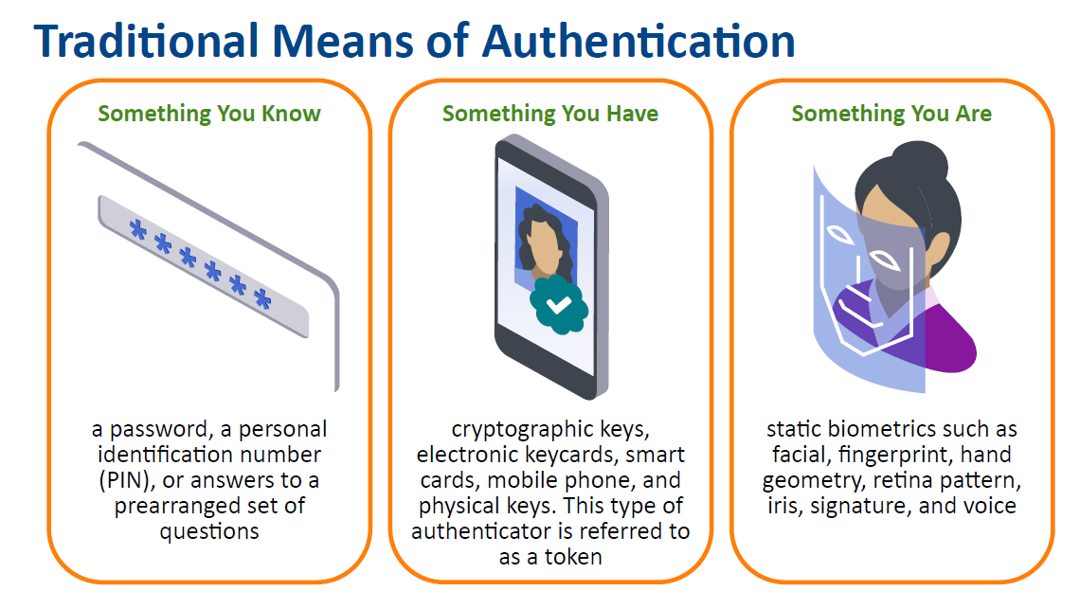

Slide 19
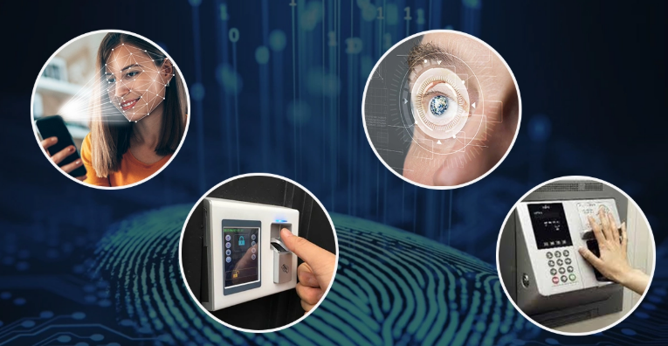
BIOMETRICS
Digital security methods that rely on biological or physiological attributes to prevent data breaches

Slide 20
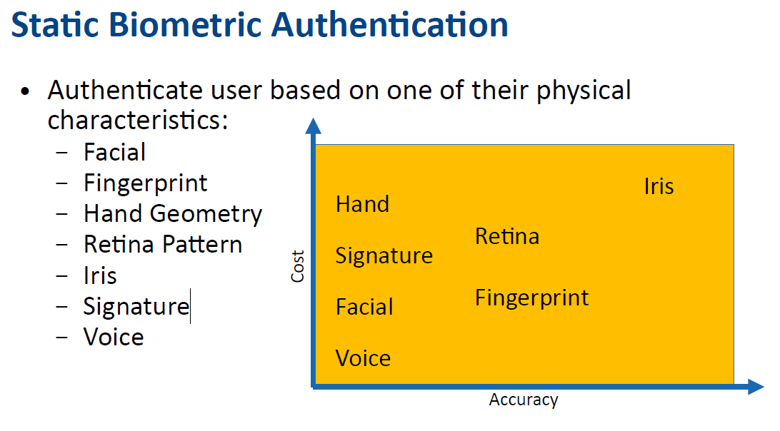

Slide 21

Types of Authentication Methods:
Facial recognition
uses a person’s unique facial features to identify them
used in a variety of places such as smartphones, credit card payments, and law enforcement

Slide 22
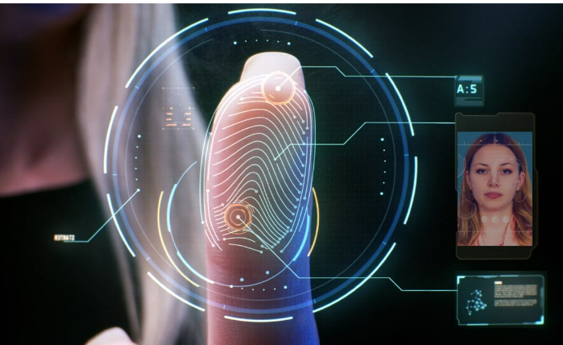
Types of Authentication Methods:
Fingerprint Recognition
uses a person’s unique fingerprint to verify their identity
it can be used to secure everything from mobile devices to automobiles, even buildings, making it the most widespread biometric authentication technology

Slide 23

Types of Authentication Methods:
Eye Recognition
uses the unique pattern of someone’s iris or retina to identify them
it’s less common than the other types of biometric authentication options
an iris scan requires an infrared light source, a camera that can see IR, and minimal light pollution in order to ensure accuracy
generally used in situations where security is most critical such as nuclear research facilities, etc.

Slide 24

Types of Authentication Methods:
Voice Recognition
uses the tone, pitch, and frequencies that are unique to an individual to authenticate them
the most commonly used biometric to verify users when they contact a call center for customer service support (for example, online banking)

Slide 25
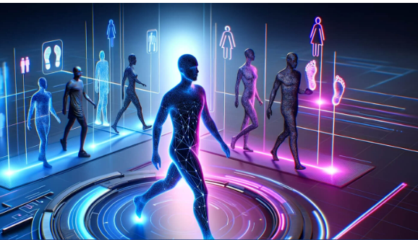
Types of Authentication Methods:
Gait Recognition
authenticates using the way someone walks to identify them
each person walks a little differently, so the way a person puts one foot in front of the other is an effective way to verify their identity
as of now, it’s not a common form of authentication but it’s expected to become more common as future forms of authentication become more popular
Gait is how an individual walks, and it can be used to create a unique biometric identifier.

Slide 26
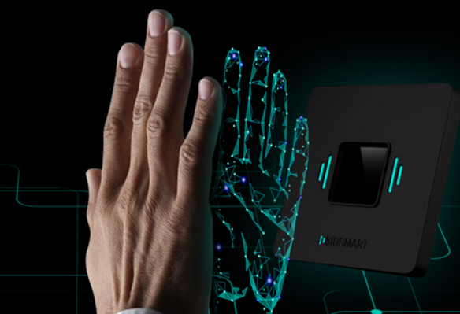
Types of Authentication Methods:
Vein Recognition
uses the pattern of blood vessels in a person’s hand or finger to identify them
uses infrared light to map the veins under the skin in your hands or fingers
extremely accurate, more than retina/iris recognition.

Slide 27
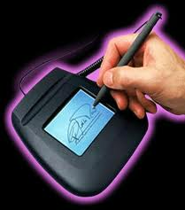
Types of Authentication Methods:
Signature Recognition
an official confirmation that a signature on a document belongs to the person who has signed it
Notes:
Other authentication methods:
Hand geometry, heartbeat, keystrokes, palm print, behavioral biometric, ear, DNA, etc.

Slide 28

INTRUSION DETECTION SYSTEM (IDS)

Slide 29
What Is An Intrusion Detection System (IDS)?
an application that monitors network traffic and searches for known threats and suspicious or malicious activity. The IDS sends alerts to IT and security teams when it detects any security risks and threats.
Most IDS solutions simply monitor and report suspicious activity and traffic when they detect an anomaly. However, some can go a step further by taking action when it detects anomalous activity, such as blocking malicious or suspicious traffic.

Slide 30
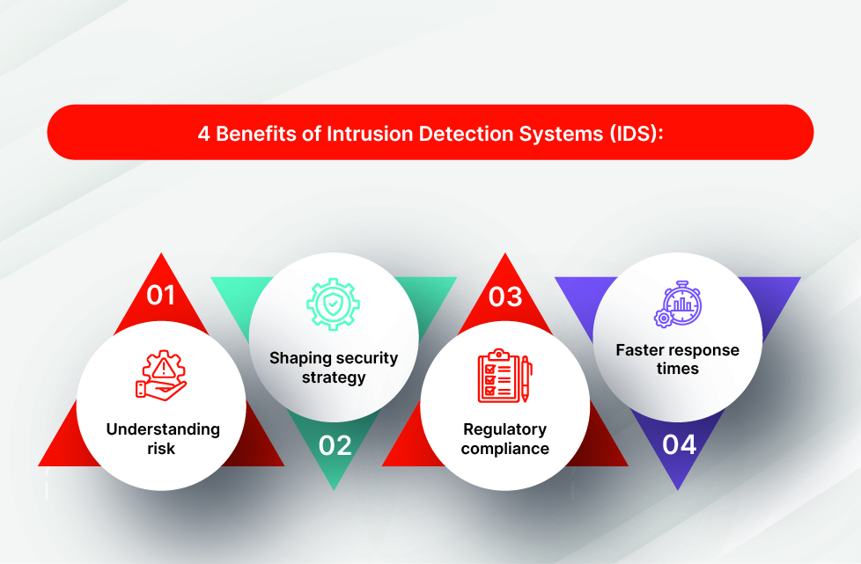

Slide 31
Why Are Intrusion Detection Systems (IDS) Important?
provides an extra layer of protection, making it a critical element of an effective cybersecurity strategy
You can use it alongside your other cybersecurity tools to catch threats that are able to penetrate your primary defenses. So even if your main system fails, you are still alerted to the presence of a threat.

Slide 32
Benefits of intrusion detection systems
1. Understanding risk: An IDS tool helps businesses understand the number of attacks being targeted at them and the type and level of sophistication of risks they face.
3. Regulatory compliance: Organizations now face an ever-evolving list of increasingly stringent regulations that they must comply with. An IDS tool provides them with visibility on what is happening across their networks, which eases the process of meeting these regulations. The information it gathers and saves in its logs is also vital for businesses to document that they are meeting their compliance requirements.
2. Shaping security strategy: Understanding risk is crucial to establishing and evolving a comprehensive cybersecurity strategy that can stand up to the modern threat landscape. An IDS can also be used to identify bugs and potential flaws in organizations’ devices and networks, then assess and adapt their defenses to address the risks they may face in the future.
4. Faster response times: The immediate alerts that IDS solutions initiate allow organizations to discover and prevent attackers more quickly than they would through manual monitoring of their networks. The sensors that an IDS uses can also inspect data in network packets and operating systems, which is also faster than manually collecting this information.

Slide 33
Intrusion detection system (IDS) challenges
1. False alarms: Also known as false positives, these leave IDS solutions vulnerable to identifying potential threats that are not a true risk to the organization. To avoid this, organizations must configure their IDS to understand what normal looks like, and as a result, what should be considered as malicious activity.
2. False negatives: This is a bigger concern, as the IDS solution mistakes an actual security threat for legitimate traffic. An attacker is allowed to pass into the organization’s network, with IT and security teams oblivious to the fact that their systems have been infiltrated.

Slide 34
What Is The Difference Between A Firewall And IDS?
IDS | Firewall
Passive monitoring tools that identify possible threats and send out notifications to analysts in security operations centers (SOCs). | Analyzes the metadata contained in network packets and decides whether to allow or prohibit traffic into or out of the network based on pre-established rules Essentially creates a barrier that stops certain traffic from crossing through it

Slide 35
Microsoft PowerPoint - Module 3-User Authentication-3
Authentication vs Authorization: Key Differences | Fortinet
Authorization and Authentication. Both the terms are often used in… | by Audira Zuraida | Medium
https://www.logintc.com/types-of-authentication/biometric-authentication/
https://www.slideshare.net/slideshow/biometric-authenticationpdf/258437560
https://www.ncsc.gov.ie/pdfs/NCSC-MFA-Guide-0723-Final.pdf
https://www.fortinet.com/resources/cyberglossary/intrusion-detection-system#:~:text=IDS%20vs%20IPS-,What%20Is%20An%20Intrusion%20Detection%20System%20(IDS)%3F,any%20security%20risks%20and%20threats.

